Slide 1
ML Training at the Edge — Federated Learning for IoT
— JB-OD-LN
COM3505, Lecture 9 Hongrui Shi Dr. Valentin Radu
Notes:
khnlhkjhlkjhkjh

Slide 2
Lab assessment 1: feedback
feedback should be available in your repo
this is a trial run for the project, so use that to inform your work for the rest of term
questions…?

Slide 3
Mock exam: Q&A
I will publish the mock exam later this week
you can do it whenever you like
it is a good way to get a sense of what the real exam will be like!
you need to pass the real exam! (pass grade: 40%)
...?

Slide 4
LA2 (project) assessment: details on Blackboard
This is an advanced course and the project assessment in particular is
intentionally open-ended. There is no single right answer! (And almost certainly no perfect answer!)
Deadline. Friday 19th May at 12 midday UK time.
Size. If you have spent e.g. 8 hours per week on the work so far, you should be able to achieve a good solution if you allocate a similar amount of time to the project each week until the end of the semester.
Marks. The assessment is marked out of 100 and contributes a possible
maximum of 60 to your score for the course. LA1 and the exam are pass/fail threshold elements of your assessment; LA2 dictates your grade after passing the other two. It is possible to pass the course without completing LA2, in which case your mark will be 40.

Slide 5
Projects: Q&A
I’m getting a steady flow of questions about this and that… note that our two discussion forums are (most years) useful for sharing:
(course in general) https://tinyurl.com/iot-disc-2024
(unPhone related) https://forum.unphone.net/
3 weeks left! plan your remaining time!
if you need components let me know after the lecture or first thing in the lab tomorrow
….?

Slide 6
Today: IoT AI #2
the problem with old AI: didn’t work!
the new AI: more data! and a structured set of neural nets
the problem(s):
faulting and hallucination aka making things up (just like people!)
insecurity: prompt injection impossible to prevent or detect
morality: who owns the source material?
some possible answers:
sandboxing, via a gatekeeper with interposed formal model
keep it local and isolated
give it back! (open source)
three summer projects: unPhone/mesh; DIY AI; talking robots
how does this work out in an IoT context? in L6 we heard from Valentin about learning at the edge, and today Valentin’s PhD student Hongrui is going to complete that story

Slide 7
About me
PhD candidate, pervasive computing group, computer science
Research topic
Federated learning, very relevant to ML applications on IoTs
Focus on efficient machine learning on the edge
Custom-size client models
Fine-tuning partial models
Active data selection

Slide 8
Recap - ML for IoT devices
Two steps:
ML model training (commonly performed in the cloud)
ML model deployment (on IoT devices)
A range of ML algorithms (decision tree, bayesian, neural networks, etc. )
Data needs to be on the server for training
Compressing the model for deployment
Quantization
Pruning
Advantages for running inferences with ML models at the edge:
low latency,
high availability,
high bandwidth,
power efficiency,
data privacy.

Slide 9
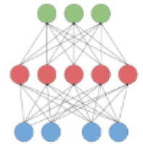
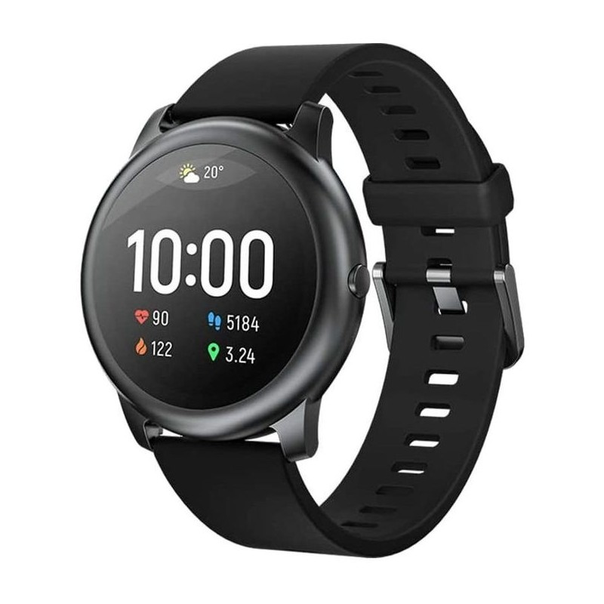

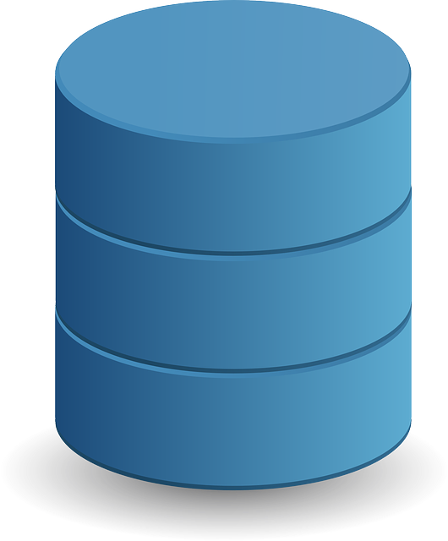
ML paradigms in the IoT space (I)
ML model resides in the cloud
Training data is on the server
Runtime samples are uploaded to the cloud for inferences
download estimation
upload data
for offline training
Runtime data
Training data

Slide 10
ML paradigms in the IoT space (II)
2) ML model at the edge
Training data is on the server
Runtime samples are processed locally on the IoT device.
upload estimation
download model
Train model
(offline)
Runtime data
Training data

Slide 11
Data for Training ML Models?
The two ML paradigms make the assumption that training data is available on the server.
Preferential privacy
a few clients contribute training data
many benefit from the trained model
Training data
Training data

Slide 12
Question?
What are the main issues with these training paradigms?
(data privacy, generalisation)
Some clients still need to upload their local data to create the training set.
Also known as centralised Machine Learning - data is brought to a central server for training.
Data may not be representative for many clients if the training data is collected from a very small fraction of clients.

Slide 13
Federated Learning (FL)
Can we train a centralised model on decentralised data?
Definition: Federated learning (FL) is a machine learning setting where many clients (e.g. mobile devices) collaboratively train a model under the orchestration of a central server (service provider), while keeping the training data decentralized.
Recent technology, proposed in 2016 by McMahan et al.: “We term our approach Federated Learning, since the learning task is solved by a loose federation of participating devices”
Google is using FL to train the word prediction feature in their android keyboard.
It is currently a hot research topic.

Slide 14
Decentralized Machine Learning
Server side distributed ML:
Splitting the training data across multiple machines
Splitting the model across multiple machines (multimodal systems)
Advantage: faster training due to parallelisation
Disadvantage: Data is still brought to some centralised nodes
Federated Learning:
Training is delegated to the clients where the data resides.
The server has access only to the model updates for aggregation.
Advantages:
Privacy due to data never leaving the customer device
Lower bias due to data being representative of the deployment conditions
Disadvantage: Takes a longer time to synchronise many clients.

Slide 15
The Federated Learning Paradigm
Some clients are registered to participate in a model update round.
The server distributes a global model to participants.
Participants update the parameters of the model based on their local data.
The parameters are sent back to the server for global aggregation.
The contributing clients may be changed in the following rounds.
Model
Update
Updates aggregation
Update

Slide 16

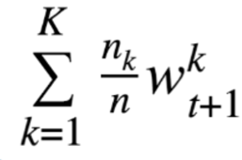

Updates Aggregation in Federated Learning
A popular approach to aggregate local updates from clients is by averaging each weight of the model from the updates (FedAvg).
Other more advanced solutions look at the specifics of local data on the client to weigh in the aggregation:
Weighted average based on number of local samples
Weighted average based on sample diversity.
Model
Update
Updates aggregation
Update

Slide 17
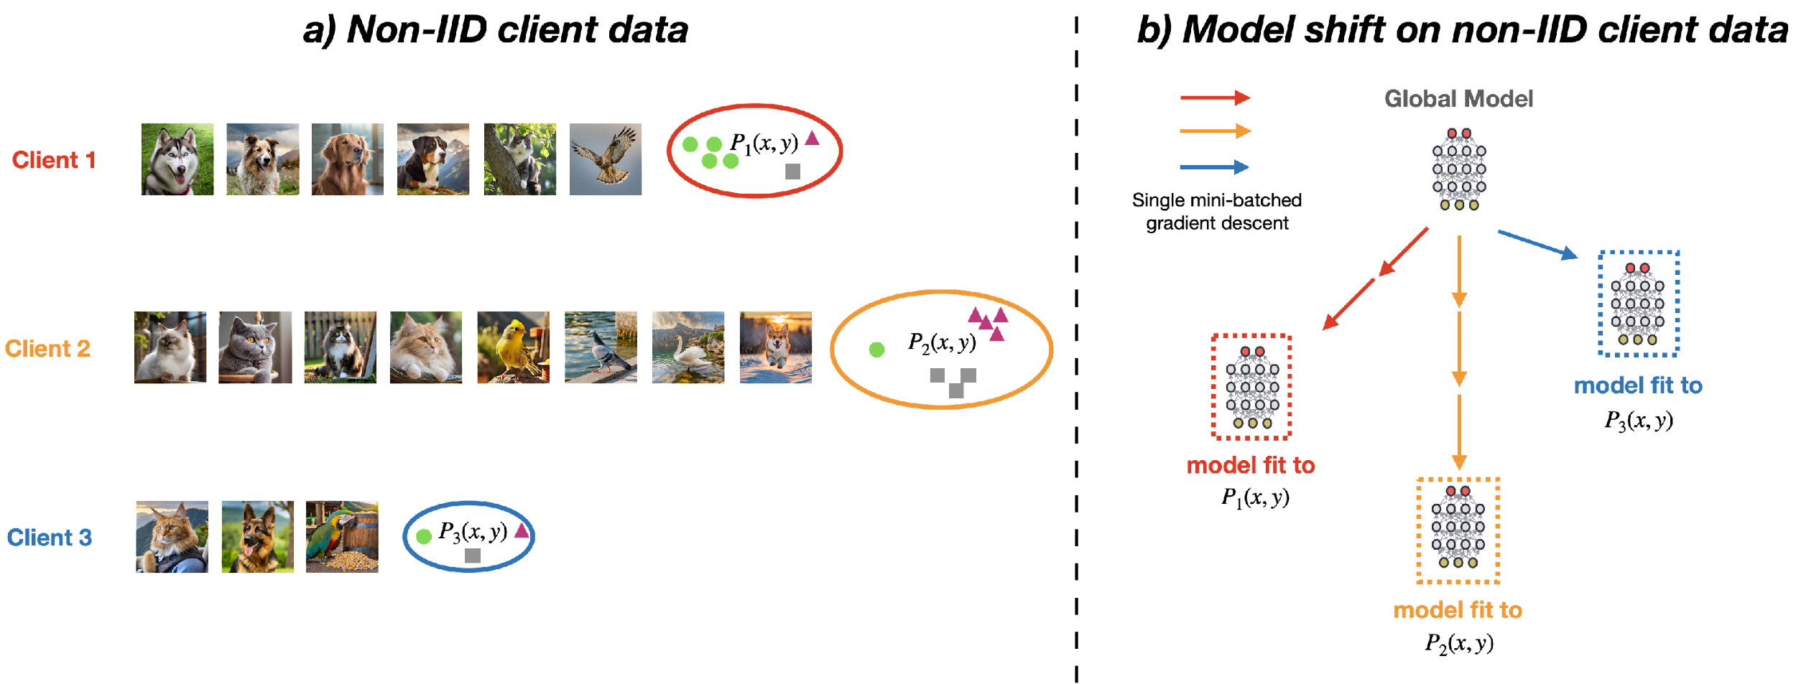
Challenges in FL
Unbalanced and non-IID (identically and independently distributed) data:
We need to include in the training many different clients.
Notes:
Can you assume all these devices and their user generated data are the same. Data heterogeneity, distribution differences.

Slide 18
Challenges in FL
Unbalanced and non-IID (identically and independently distributed) data:
We need to include in the training many different clients.
Many unreliable devices:
Some clients may be included in a local update round but never finish the round (not sending their updates to the server): not finishing their local round before a preset deadline.
Limited communication bandwidth
Clients with 3G/GPRS connection may be slower than those on broadband.
Limited resources
Battery lifetime constraints
Network connectivity cost

Slide 19
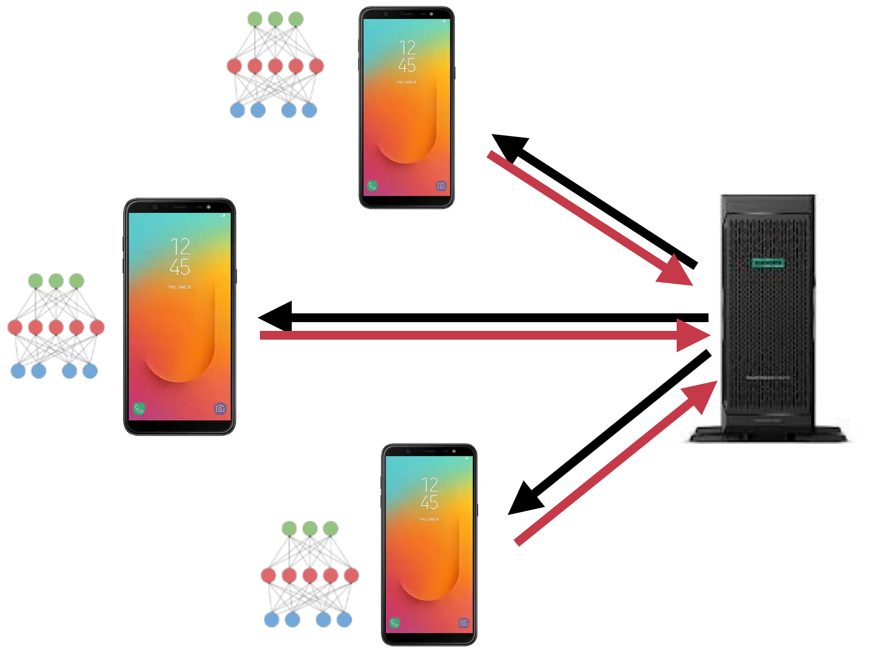
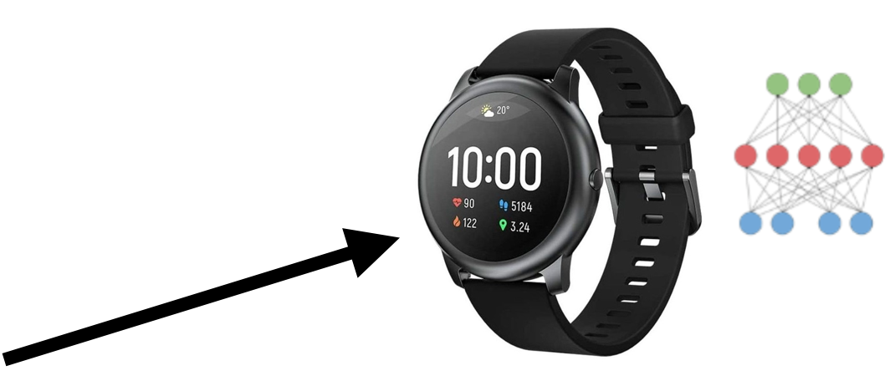
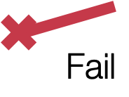
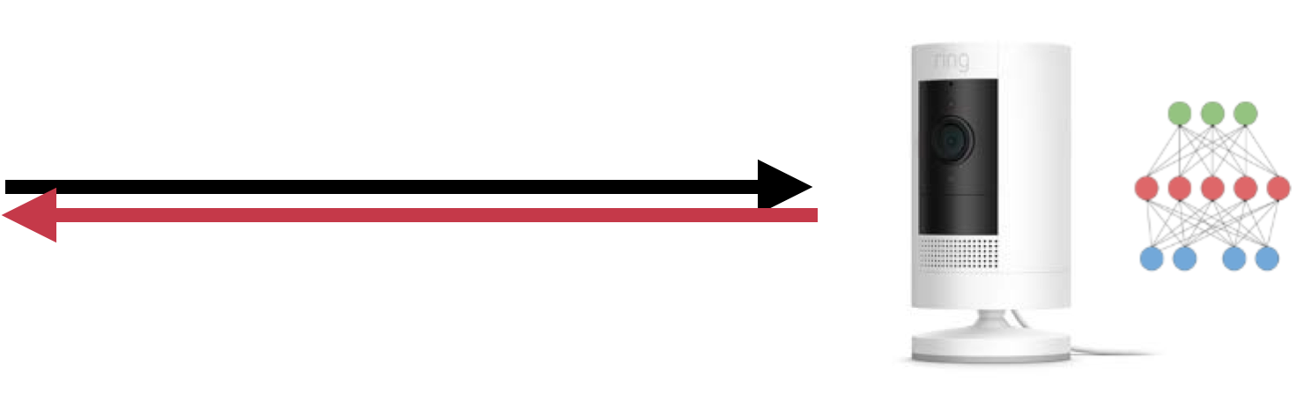
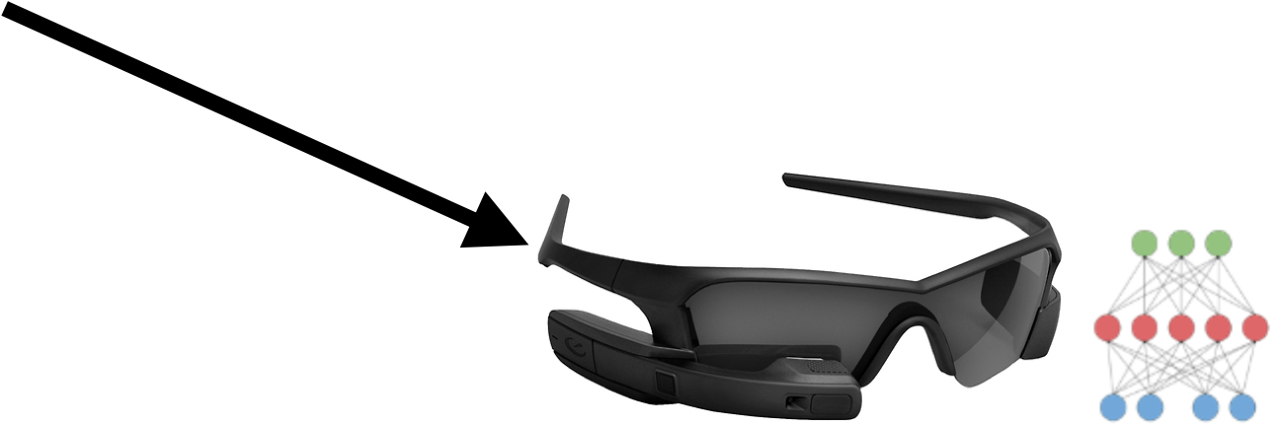
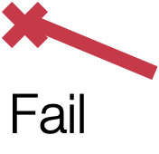
Hardware Heterogeneity Challenge
FL works well for devices with similar computing capabilities
Slower clients will stall the training process
Faster clients wait after the slower ones (increased round deadline)
Or waste computations from those clients that don’t finish before a decent deadline.

Slide 20
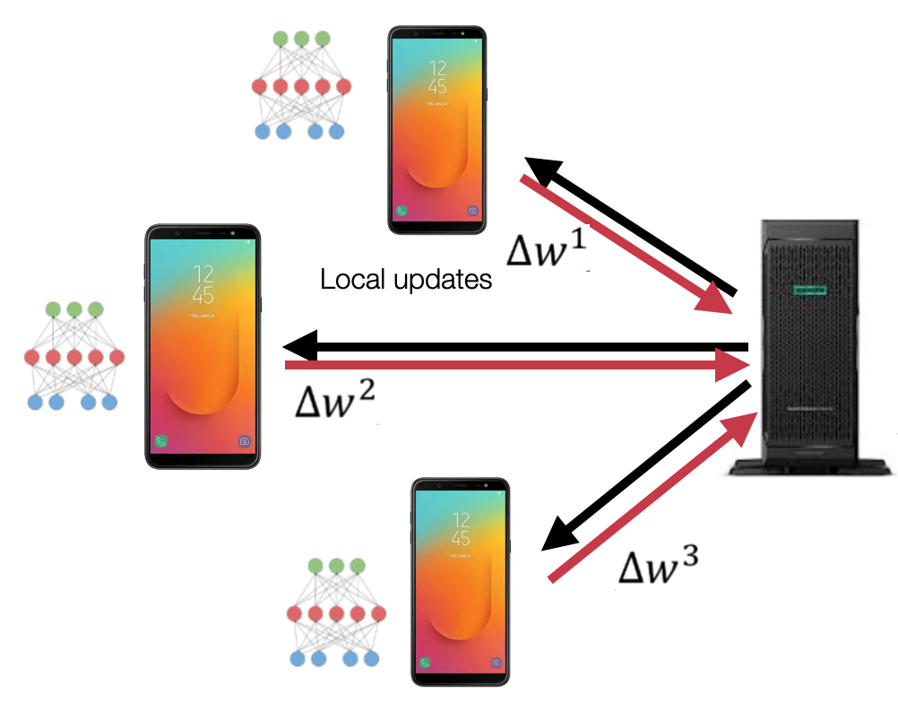
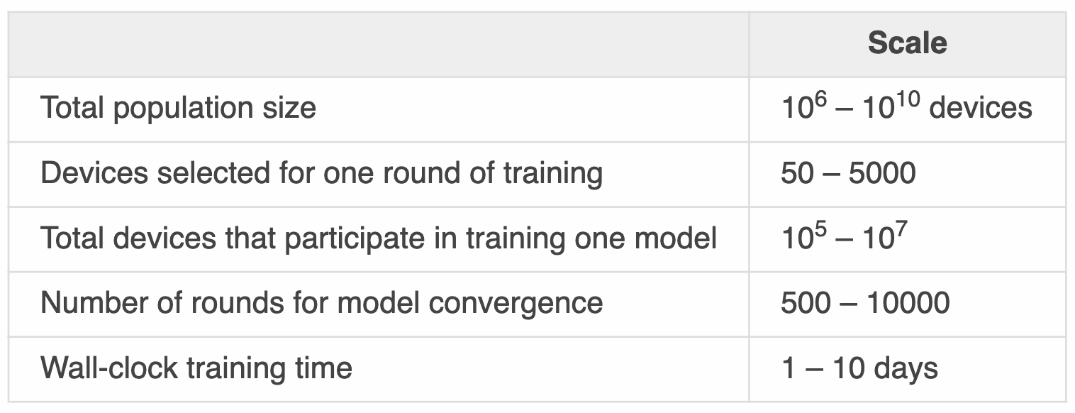
Scale of FL
Word prediction in Google Keyboard
Notes:
How serious is the client drop out

Slide 21
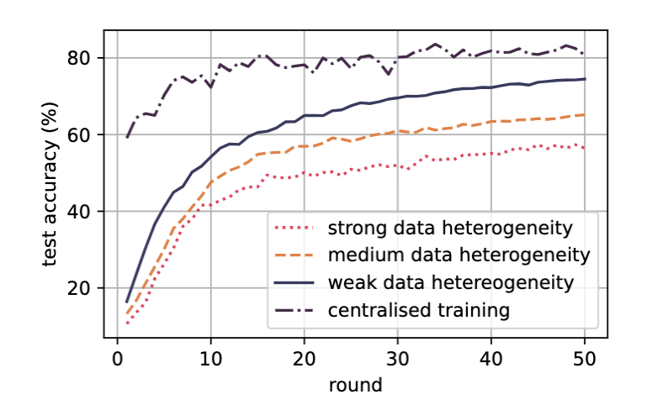
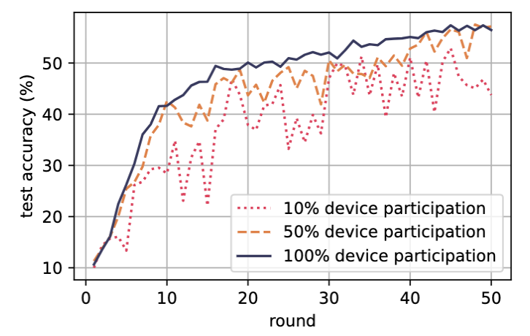
Challenges in FL
Learning Curves on CIFAR-10
Stronger data heterogeneity leads to worse FL performance
More serious device dropout leads to worse FL performance
Data heterogeneity—non IID data
Device dropout
Notes:
Data heterogeneity, distribution differences.

Slide 22
Directions in workload reduction for IoT
Custom-size client models
Fewer local training samples (strategically selected)
Training just a smaller part of the model (fine-tuning/domain adaptation)
Fewer global rounds by faster model convergence (reducing model shifts)

Slide 23
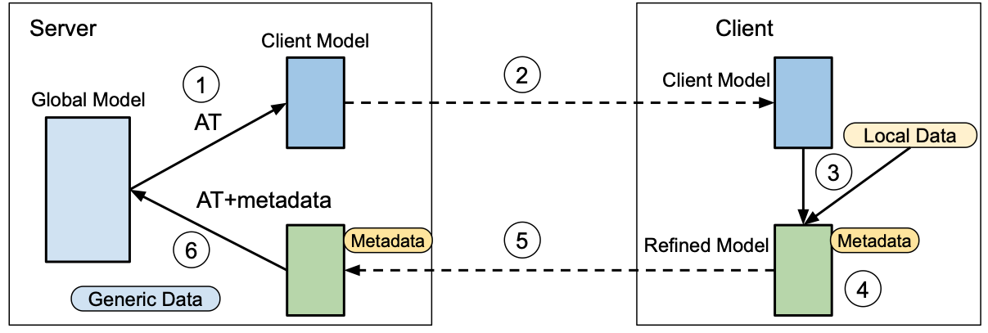
Custom size client models
Research is now developing new solutions for mitigating the issue of struggles (clients that cannot finish the round in time).
Compressing the model sent to the client such that the new model fits the computing capability of the device, allows the client to finish the round in time.
[H. Shi, V. Radu, EdgeSys 2021]

Slide 24
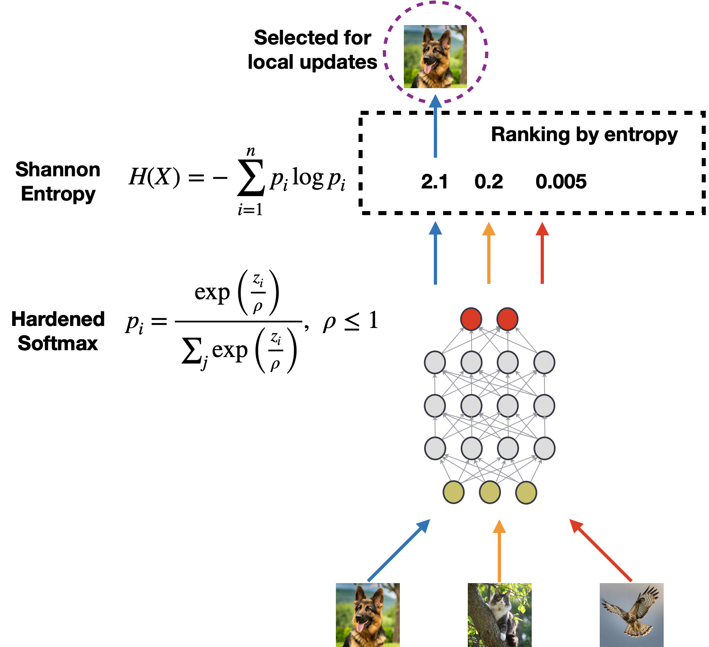
2. Fewer local training samples
Reduce training time by formulating a small training set
Improve FL performance by selecting the most useful samples locally for learning
Notes:
Reduce the training data size. The idea is we can reduce the training time by using a small subset of user data rather than using all user data.

Slide 25
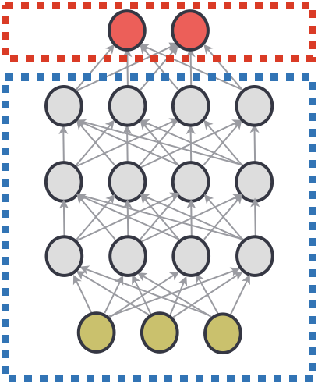
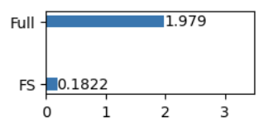
3. Training just a smaller part of the model
Train a partial model with fewer parameters leads to less workload
How to train the fixed part
Pretraining
Train it inside FL loops on powerful clients.
Parameter aggregation is ok
Trainable
Fixed
Training time comparison
Notes:
More context.

Slide 26
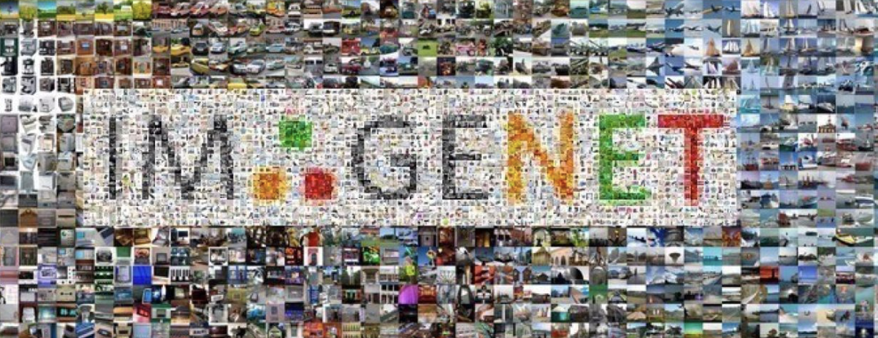
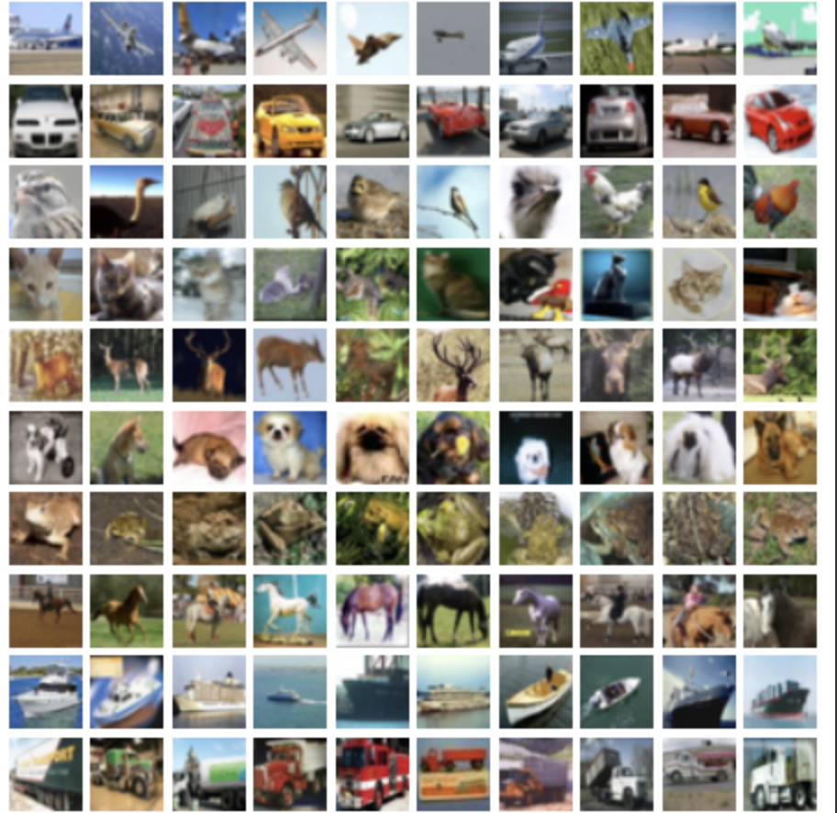
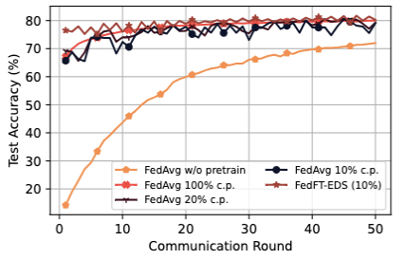
4. Fewer global rounds (faster convergence)
Transfer learning
Leverage the knowledge learned from source domains on target domains
Accelerate the convergence on target domains
CIFAR-10
ImageNet, over 1m samples
Notes:
More descriptions in slide

Slide 27
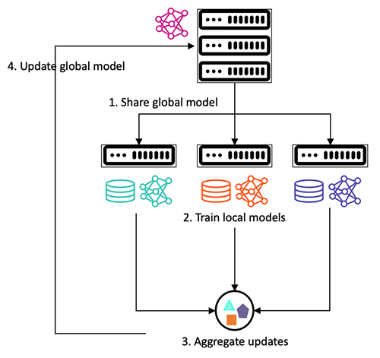
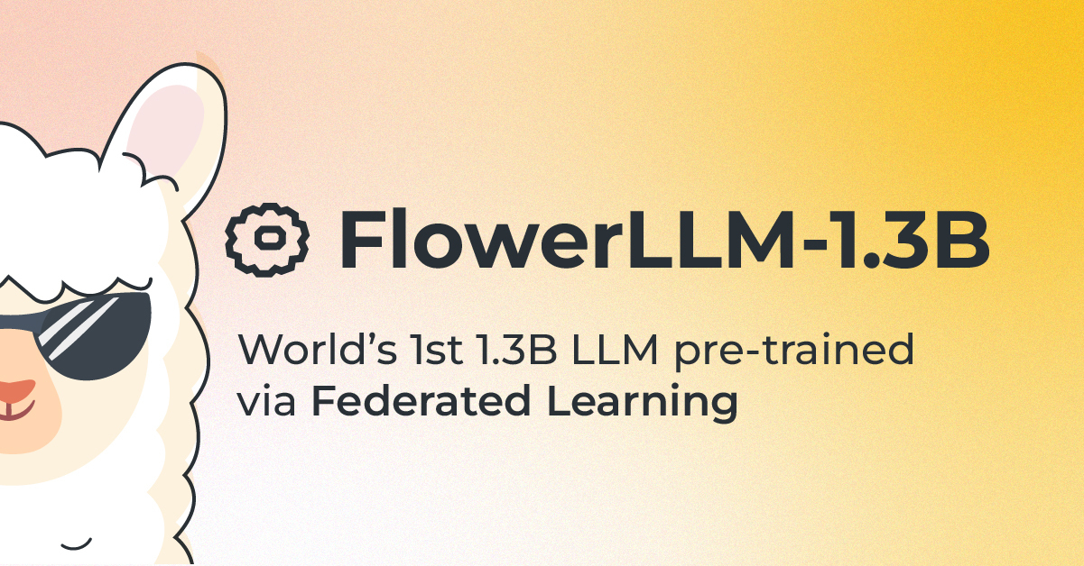
Recent breakthroughs in FL
FedML has support on AWS
The Flower community introduces FlowerLLM

Slide 28
Future Directions of FL
Focusing more on semi-supervised, unsupervised learning due to lack of labels, but taking advantage of the unfair advantage: data and compute
Foundation Models training is massively parallel due to the large size of models. Fine-tuning for specific narrower applications could be done in groups of FL clients
Better optimisers for faster convergence

Slide 29
Summary
Traditional Machine Learning requires training data to be available on a central system (also called centralised ML).
Federated Learning has emerged as the best viable solution to train a Machine Learning model across many devices without needing to move data from its source.
Federated Average is the most common method for local updates aggregation to update the global model.
Challenges in Federated Learning still remain:
Heterogeneity of data and system capabilities
Unreliable client systems
Resource limitations (battery lifetime, network cost, bandwidth)

